Slide 1
Group Chief Audit Officer Update
Board Audit Committee
Date: 20 April 2026

Slide 2
GIA Executive Summary
Executive Summary · Board Audit Committee · 20 April 2026
01
Controlled Focus Testing (CFT) Programme
CFT Programme Overview
Slide 3
GIA's targeted independent assurance response to the current geopolitical crisis — covering emergency change governance, cyber resilience, credit policy, customer fulfilment, liquidity risk and regulatory compliance.
CFT Summary; Line of Sight & Management Action
Slide 4
CFT Coverage & Value Delivery; CFT Status & Summary
Slide 5 - 8
02
Annual Audit Plan & Key Findings
FY2026 Audit Plan Status; Issued Report Ratings
Slide 9
FY2025 Audit Plan Completed. FY2026 plan on track. Key high-risk rated findings and related risk themes from audits issued since the last BAC meeting.
Key Findings & Risks
Slides 10 – 11
03
Management Actions & Risk Trends
Aging Analysis
Slide 12
Open action aging, overdue action updates, thematic risk trends & division-level breakdown. Deep dive on open actions and summary of extensions under Agenda item 4.2.
Overdue Updates
Slides 13 -16
Risk Trends — Open Actions
Slides 17 -18
Deep dive on Open Management Actions; Extensions
Agenda 4.2
04
Functional & Regulatory Updates
CBUAE Action Plan Validations
Slide 19 - 20
CBUAE action closures validated by GIA; GIA Finding & Conclusion CBUAE Examination Edenred – Finding 3/Action C.
CBUAE Limited Scope review on Control Functions actions on GIA independently validated by GT (Annex 8.19); subsequently validated & closed in CBUAE’s recent follow up review.
GIA Audit Reports (Annexure 8.4) and CFT Reports in Annexure 8.15-17
GIA Findings & Conclusion CBUAE Examination Edenred; Finding 3
Slide 21 - 22
BAC Satisfaction Survey Results FY 2025
Slide 23
2

Slide 3
GIA Assurance Response to the Crisis – CFT Programme
GIA has activated a Controlled Focus Testing (CFT) programme providing the BAC with an independent assurance over critical controls & management mitigations across all areas being reported to the Board.
01
Why CFT
02
How it is designed
03
What it delivers
• Crisis has compressed standard controls emergency changes, workarounds & temporary processes require independent validation.
• Standard audit cycles cannot match the pace of crisis developments.
• Crisis conditions demand a higher cadence of independent assurance.
• Narrowly scoped, risk-specific reviews aligned to live crisis risks and management's own reported mitigations.
• Rapid turnaround per review; concise action-oriented outputs; no formal High/Medium/Low grading.
• Spans all management board reporting areas; minimally disruptive & fully independent.
• Independent validation that crisis-driven changes were executed within acceptable control thresholds.
• Early identification of residual risks from temporary or expedited arrangements.
• An additional independent layer of assurance to complement management's reporting, giving BAC a complete picture of control effectiveness during the crisis.
COVERAGE AREAS - Anchored to Management's Key Risks & Mitigations as part of the Business Continuity Plan (BCP)
Technology Concentration Risk (Cloud Region Dependency)
Third-party Exposure
Customer Confidence Risk
Liquidity / Market Volatility
Credit Quality Stress in Affected Sectors
Colleague Stress / Resilience
Findings will be reported directly to the BAC at each scheduled meeting, complementing management's own reporting to the Board.
3

Slide 4
GIA CFT – Line of Sight: Risk, Management Action & Independent Testing
Management Key Risk (Key Risks & Mitigations | Management's Key Update / Mitigation (Key Updates by Area — Board Presentation | GIA CFT — Independent Testing (Confirmed CFT assignments)
Technology Concentration Risk (Cloud Region Dependency) | Phased migration to AWS Ireland completed; DSO data centre move done; technology resilience plan (escalating failure scenarios) in development. | Emergency changes, workarounds & architectural decisions following the AWS UAE incident; assess whether appropriately governed, authorised, risk-assessed & controlled without introducing undue operational, security or regulatory risk.
Third-party Exposure & Cyber Threats | Cyber posture heightened: continuous monitoring, threat intel tracking, phishing/scam advisories; specific actions for Iran-linked threat actors; third-party controls tightened. | Assurance over timely detection, escalation, and remediation of cybersecurity incidents during the crisis, and maintenance of an effective security posture despite temporary SOC monitoring changes.
Customer Confidence Risk | 2FA restored; customer-facing channels available; centrally approved communications; RM outreach to key UHNWI/HNWI clients; digital channel functionalities normalized. | Three CFTs mitigate this risk covering Digital Banking workarounds and OTP migration; Customer Fulfilment BCP, workarounds and communications governance; and Customer Protection & Conduct, including fair treatment, service continuity and CB compliance across the card lifecycle.
Credit Quality Stress in Affected Sectors | Credit posture tightened: segment-by-segment review, pause on higher-risk new lending, daily high-limit card monitoring. Pipeline controls for trade finance & mortgages. | Two CFTs mitigate this risk covering credit policy compliance and portfolio assessment for RAK Business Loans, and credit risk governance and exposure stability within the Credit Cards portfolio during market volatility.
Liquidity / Market Volatility | Liquidity within MAT/CFP limits; ELAR trigger; deposits monitored hourly; contingency funding scenario planning; leadership dashboards shared intraday. | Assessment of the completeness, quality, and decision‑usefulness of liquidity risk information supporting crisis decisions, including transparency over limitations and assumptions.
GIA-Initiated Assessment (Regulatory & Financial Crime Compliance Exposure) | N/A- GIA-initiated area of focus, not mapped to a specific management identified key risk. Forms part of GIA's broader assurance response to the crisis. | Assessment of crisis‑related regulatory communications and reporting, including accuracy, completeness, alignment with expectations, and implementation of regulatory guidance.
GIA-Initiated Assessment (BCM & Operational Resilience) | N/A- GIA-initiated area of focus, not mapped to a specific management identified key risk. Forms part of GIA's broader assurance response to the crisis. | Assessment of the adequacy and effectiveness of the Bank’s BCM framework, including crisis response timeliness, governance, coordination, and alignment with BCPs and regulatory requirements.
4

Slide 5
GIA CFT Assignments – Coverage & Value Delivery
10 Assignments Confirmed
5 GIA Verticals Covered
Potential for Additional CFTs
# | CFT AREA / THEME | VALUE DELIVERY
1 | Cloud Operations, Resilience, and Crisis Controls | Independent assurance over crisis‑driven changes, ensuring controls remained within acceptable risk thresholds and identifying residual risks requiring formalization, acceptance, or remediation.
2 | Cybersecurity Incident Monitoring, Threat Response & SOC Operations | Assurance over the effectiveness of cyber detection and response during heightened risk, confirming appropriate action on regulatory advisories and IOCs, and identifying residual risks requiring remediation or formal acceptance.
3 | Digital Banking Temporary Workarounds RAK Token & Limit Enhancements | Independent assessment of whether the migration from RAK Token to OTP and limit enhancements for WBG & BBG adequately managed the heightened app authentication and security risks introduced during the digital banking transition.
4 | Customer Fulfilment; BCP, Workarounds & Customer Impact | Validation that credit risk discipline was consistently maintained, with assurance that credit limit decisions were risk‑driven, appropriately governed, and resilient to operational disruption, and that credit exposure was not inadvertently expanded due to weakened controls, system issues, or crisis‑driven interventions.
5 | Customer Protection & Conduct Credit Cards Lifecycle | Assessment of whether the Bank continued to serve customers effectively and applied relief measures consistently and fairly, with identification of any instances where temporary operational disruptions resulted in customer disadvantage, financial harm, poor outcomes, or erosion of trust.
5

Slide 6
GIA CFT Assignments – Coverage & Value Delivery
10 Assignments Confirmed
5 GIA Verticals Covered
Potential for Additional CFTs
# | CFT AREA / THEME | VALUE DELIVERY
6 | Credit Policy Changes & Portfolio Assessment; RAK Business Loans | Assessment of the portfolio‑level impact of market disruptions on RAK Business Loans, with validation that revised credit policy amendments are being implemented consistently, both manually and system‑based, across affected WBG and BBG portfolios.
7 | Credit Risk Governance & Exposure Stability; Credit Cards | Validation that credit risk discipline was consistently maintained, credit limit decisions remained risk‑driven and appropriately governed, and credit exposure was not inadvertently expanded due to control weaknesses, system issues, or crisis‑driven interventions.
8 | Liquidity Risk Information, Completeness & Quality | Provide assurance that crisis decisions are based on reliable and transparent risk information.
9 | Regulatory Compliance and Regulatory Returns | Provide assurance that regulatory engagement and reporting during the crisis is transparent, accurate, and well-governed.
10 | BCM Adequacy & Crisis Response Governance | Independent assurance over the effectiveness of BCM and crisis response, alignment of BIAs, RTOs and recovery strategies to current operations, preparedness for regional and geopolitical risks, and effective governance of crisis decisions and escalations.
6

Slide 7
CFT Summary – Status & Report Summary as at 20 April 2026 (1/2)
The following summarises the status and key findings of CFT reviews as at the date of this BAC meeting. Reports of completed CFT’s are included in the BAC Reading Deck (Annexure 8.15-8.17).
CFT Area / Theme
Management Key Risk
Report Issued
Report Summary
Credit Policy Changes (RAK Business Loans)
Refer Annexure 8.15
Credit Quality Stress in Affected Sectors
In response to the crisis, Credit Risk, working with Product and Credit, instituted temporary, targeted policy measures for identified vulnerable sectors. Relevant system parameterization has been implemented to support consistent application.
10-Apr-26
Cloud Operations, Resilience, and Crisis Controls
Refer Annexure 8.16
Technology Concentration Risk
In response to the crisis, the impacted AWS UAE cloud services were rapidly re‑established in the AWS Ireland region. The accelerated execution highlighted opportunities to strengthen control maturity in select areas. Enhancing patching, DR testing, privileged access management, asset visibility, and emergency change governance will improve long‑term resilience and auditability.
13-Apr-26
Regulatory Compliance and Regulatory Returns
Refer Annexure 8.17
Regulatory & Financial Crime Exposure
The CFT concluded that controls are generally effective, and regulatory returns are properly prepared, with few required actions and enhancement areas identified. Improvements relate to deposit movement definitions, disclosure of remaining deposit balances, and basic documentation of regulatory reporting processes. Regulatory approvals for offshore data migration were confirmed.
Report Issued
13-Apr-26
● Reports Issued 3 reviews completed .
7
RAKBANK | CONFIDENTIAL | GIA – GCAO Update

Slide 8
CFT Summary – Status & Report Summary as at 20 April 2026 (2/2)
Continued from previous slide. 3 reviews are ongoing and 4 additional reviews will commence by the end of April.
.
CFT Area / Theme
Management Key Risk
Status
Report Summary
CFT Area / Theme
Management Key Risk
Status
Customer Protection & Conduct — Credit Cards Lifecycle
Customer Confidence Risk
Customer Fulfilment — BCP, Workarounds & Customer Impact
Customer Confidence Risk
Scheduled April end
Report Issued
Ongoing
BCM Adequacy & Crisis Response Governance
BCM / Operational Resilience
Credit Risk Governance & Exposure Stability — Credit Cards Portfolio
Credit Quality Stress in Affected Sectors
Scheduled April end
Ongoing
Report Issued
Digital Banking Temporary Workarounds (RAK Token & Limit Enhancements)
Customer Confidence Risk
Cybersecurity Incident Monitoring, Threat Response & SOC Operations
Third-party Exposure & Cyber Threats
Report Issued
Scheduled April end
Ongoing
Liquidity Risk Information — Completeness & Quality
Liquidity / Market Volatility
Scheduled April end
● 3 Ongoing reviews to be reported at next scheduled BAC meeting. 4 reviews scheduled to commence end of April.
8

Slide 9
GIA Audit Plan Status FY 2026
36
Total in
FY2026 Plan
6
Completed
17%
6
In Progress
17%
24
Upcoming
66%
■ Completed 6
■ In Progress 6
■ Upcoming 24
FY2025 REPORTS — ISSUED SINCE LAST BAC
IN-PROGRESS AUDITS
3 audits · FY 2025 Audit Plan Completed.
6 audits in-flight— split by stage
#
Audit Report
Rating
Issued
FIELDWORK
1
Trading, Investments & Market Risk
Needs Improvement
06-Mar-26
#
Audit
2
Financial Crime Compliance (IT Controls)
03-Mar-26
1
Capital Adequacy Ratio (CAR)
Satisfactory
3
Financial Crime Compliance
Needs Improvement
04-Mar-26
2
Information and Cyber Security Operations
4
FCC split into two reports; FCC and FCC (IT Controls)
06-Mar-26
3
Personal Loans
Group Human Resources
Needs Improvement
FY2026 REPORTS — ISSUED SINCE LAST BAC
PLANNING
6 audits · Issued Feb–Apr 2026
#
Audit
4
Branches
#
Audit Report
Rating
Issued
1
Pillar 3 Disclosures for YE 2025
Satisfactory
17-Feb-26
5
Network Architecture & Resilience
2
Protego (Integrated)
Needs Improvement
02-Apr-26
6
Card Operations
3
ICAAP
Satisfactory
03-Apr-26
Capital Adequacy split to 2 reviews; ICAAP and CAR (current in Progress)
AUDIT PLAN UPDATE
4
Shared Services
Satisfactory
09-Apr-26
BAC approval is sought to update the 2026 Audit Plan by adding a Climate Risk audit in response to a recent CBUAE request and deferring the BRF audit to 2027 due to the postponement of CBUAE SupTech project to early 2027.
5
Credit Governance & Provisions
Needs Improvement
13-Apr-26
6
Legal
Satisfactory
14-Apr-26
9

Slide 10
Summary of Key High Risk Findings (Audit Reports Issued Post BAC # 1 ~ 27th January 2026)
Audit Report | Key Findings and Risks | Action Plan/Status
RAKINSURANCE ADHICS Compliance
Oversight in Cloud Hosting Outsourcing Arrangements [ECD/ICD: 30/04/2026] RAKINSURANCE migrated its critical infrastructure to AWS UAE Cloud without obtaining CBUAE’s non-objection approval and completing outsourcing and materiality assessments potentially exposing the organization to regulatory non-compliance. | Outsourcing and materiality assessment documents have been prepared along with Group TPRM and Outsourcing teams. These documents are being reviewed with RAKNIC audit and compliance team before sending the NOC for CBUAE approval.
B. Gaps in 3rd-Party Risk Management & Subcontracting Controls [ECD/ICD: Closed] Deficient outsourcing and third-party governance were noted, including misclassified materiality, unauthorized subcontracting, offshore operations without risk mitigation, and missing due-diligence controls, which may result in data exposure, and security risks. | Management has completed governance and regulatory remediation, including contractual regularisation, strengthened data protection and oversight controls, updated outsourcing classification, and initiation of TPRAs for AWS and NetFence, with a CBUAE NOC request submitted for the material arrangement.
C. - Deficiencies in RAKINSURANCE’s AWS Security Posture [ECD/ICD: 31/08/2026] Cloud security controls require enhancement, as current misconfigurations have resulted in weak encryption practices, overly permissive storage access, bypass of privileged‑access safeguards, and other configuration gaps. | Key AWS cloud security control gaps have been addressed; remediation efforts are ongoing to further protect sensitive healthcare data through customer‑managed encryption and enforce controlled administrative access.
NSI
Refer to Annex 8.20 for Status Update on Management Actions
Financial Crime Compliance
Weaknesses in the Business Risk Assessment [ECD/ICD: 30/06/2026] The BRA continue to improve however the Audit evidenced a number of gaps that should be addressed including limited UAE-specific typology integration, inconsistent AML/CFT case management and STR insights, mixed inherent-vs-control factors analyses, misaligned AML/CTF/CPF weightings, data quality issues and late submission. | The BRA will be enhanced to include UAE‑Specific typologies in Inherent Risk assessment, insights from case management and STR reporting. The risk factor weights will be revisited and justified in addition, data quality and timeliness of BRA completion and reporting will be ensured.
B. Gaps in Vendor/ 3rd Party Sanctions Screening [ECD/ICD: 31/12/2026] Deficiencies were noted in vendor/third‑party sanctions screening including inconsistent Ultimate Business Owner (UBO) identification, signatory screening and lack of clarity on constitutional documents to be obtained and reviewed. | Management has established a comprehensive action plan to allow a proper identification and automated screening of UBOs, and authorised signatories which will entail obtaining the required information to justify shareholder information and ownership.
C. Governance Around Customer EDD [ECD/ICD: 15/07/2026] The current Enhanced Due Diligence (EDD) approval delegation of authority for Foreign Politically Exposed Persons (FPEPs) is not aligned with the regulatory requirements. Also, temporarily delegation of authority has not been systematically done in compliance with the Policy. | The delegation of authority to approve a FPEP relationship will be aligned with the regulatory requirements. In addition, compliance with the requirements of the delegation of authority policy will be systematically ensured.
NI
H
M
M
Ref: Annexure 8.7
*ICD/ECD: Interim/Estimated Completion Date
NSI : Needs Significant Improvement | NI : Needs Improvement
10

Slide 11
Summary of Key High Risk Findings (Audit Reports Issued Post BAC # 1 ~ 27th January 2026)
Audit Report | Key Findings and Risks | Action Plan/Status
Credit Governance & Provisions
Staging and Days Past Due (DPD) computation [ICD: 30/09/2026] Expected Credit Loss staging is not fully regulatory aligned, as retail staging uses overdue‑to‑instalment ratios instead of DPD, and non‑retail DPD reporting has incomplete coverage which could result in delayed stage migration. | Management will assess the impact of the current retail staging logic and evaluate system enhancements for DPD alignment, while enhancing non‑retail DPD reporting to ensure complete portfolio coverage.
Collateral update [ICD: 30/09/26] Inaccurate and incomplete capture of group‑level collateral, Debt Service Reserve Account balances (DSRA), reverse repo collateral, and delayed/missed collateral updates in systems, resulting in overstated Expected Credit Losses. | Management is enhancing collateral data capture, reporting, and validation controls, assessing the inclusion of DSRA and reverse repo transactions subject to relevant approvals, while continuing to strengthen system updates and collateral governance in alignment with CRMS expectations.
NI
Ref: Annexure 8.13
*ICD/ECD: Interim/Estimated Completion Date
NI : Needs Improvement
11

Slide 12
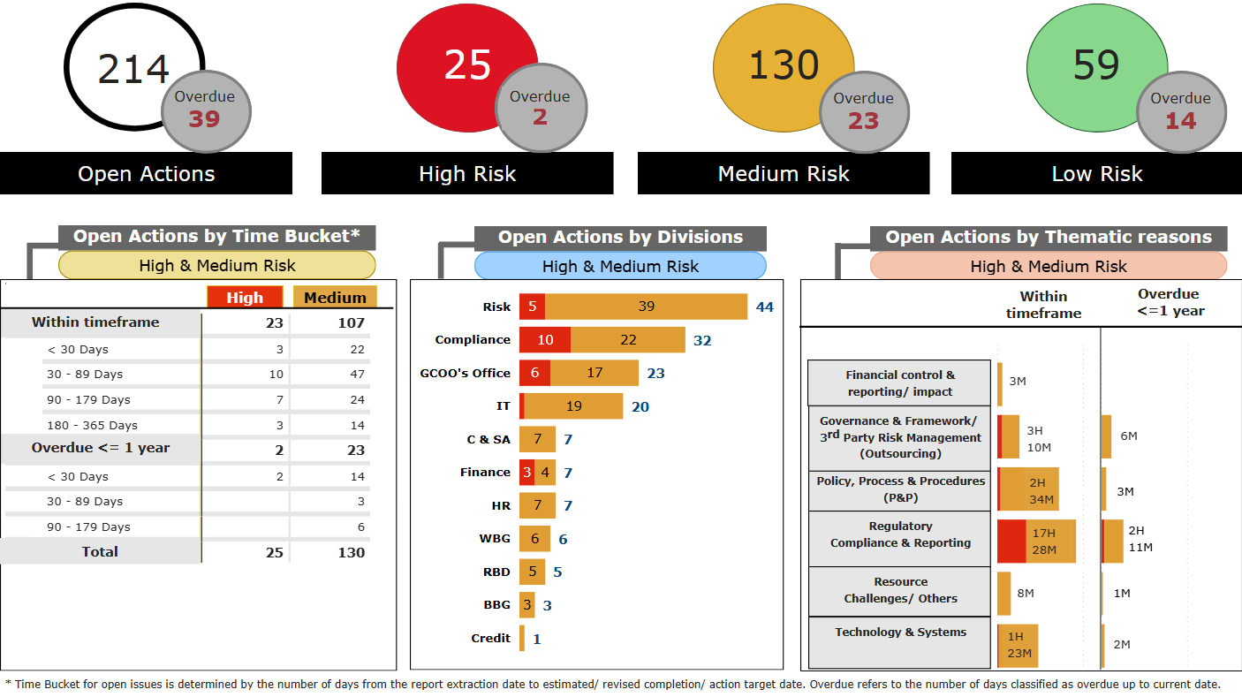
Open Management Actions – Aging Analysis (RAKBANK excl. RAKislamic & RAKINSURANCE)
Management Actions* released - 2026 YTD
13
64
46
Management Actions* closed - 2026 YTD
18
113
40
* Actions excludes those related to RAKislamic and RAKINSURANCE divisions, and Audit Reports recently released including actions from GIA audits; AFIs and unrated actions are also excluded.
12
Data as of 14-Apr-26

Slide 13
Management Actions Overdue < 30 days - HIGH Risk (RAKBANK)
S# | Audit Name | Issue | Management Action Summary | Owner & Last Agreed Date | Latest Update | Mitigating Controls
1 | Shared Services & Strategic Outsourcing Report Issue Date: 01/10/2025 | Finding 2: Compliance with Outsourcing Regulation and Standards | The framework for assessing the aggregate risk from all outsourcing arrangements, as well as the marginal risk of any proposed outsourcing arrangement will be included in the Bank’s overall risk governance framework by TPRM team. The risk aggregation and marginal risk will be done at a vendor level considering the residual risk. This framework will be added to the Operational Risk Module of Archer by December 2025. The framework will be tabled to the Board/BRC in Feb 2026. This exercise would have dependency on the VMO team regarding the residual risks at Vendor level. To operationalize the framework, assessments completed by VMO till March 2026 will be considered for initial risk aggregation along with marginal risk evaluation. It will be a continuous activity, updated as additional vendor assessments are completed by VMO. | Farhan Mahmood; Jiju Thomas Philip 31-Mar-26 | Under GIA validation. | An approach for monitoring aggregated and marginal risks arising from outsourcing arrangements has been defined and presented to the Management Risk Committee and the Board Risk Committee in February 2026, in line with the agreed management action.
2 | Group Market Conduct Report Issue Date: 10/10/2025 | Governance, Oversight & Compliance Framework | Risk Appetite statements are currently work in progress. | Venkat Raghavan Manisha Maria Miranda 31-Mar-26 | The Conduct Risk Appetite Statement has been embedded into the revised Conduct Compliance Policy approved by MCRC, with KRIs currently under development and targeted for completion by April 2026. | Conduct Risk Appetite Statement has been formalized. KRIs are being tracked for finalization by end of Apr’26.

Slide 14
Management Actions Overdue > 90 days - MEDIUM Risk (RAKBANK)
S# | Audit Name | Issue | Management Action Summary | Owner & Last Agreed Date | Latest Update
1 | Group Market Conduct | 9 – Due diligence on outsourced employees | There is a broader discussion to this – for now, partial checks rest with the current Onboarding/People Operations Team. However, as mentioned discussions are underway on how to best institutionalize the same. | Sultan Khalifa Al Ali; Sonal Hingorani 31-Dec-25 | Currently HR is working with the Procurement and Outsourcing teams to revisit the current process and policy. Extension of completion of action by 31-May-26 will be sought.
2 | Enterprise Risk Management 2025 | Finding 1 – Significant Delay in the Delivery of the Risk Automation Project | 1.1a Risk will review scope of the Risk Automation Project by splitting it into two phases: (1) critical risk reports will be automated within the timeline communicated to the CBUAE, and (2) non-critical reports will be automated beyond 2025. Project monitoring will be also further enhanced. | Farhan Mahmood; Ahmed Lasheen 31-Dec-25 | The Vendor “Optimum” have submitted a plan end of last year where the completion was moved from Dec 2025 to June 2026. After internal discussions, we have clearly seen that Optimum cannot deliver the work even by June 2026. We are submitting a change of approach within the existing funding to salvage the project and get it delivered and will share an update communication with the CBUAE regarding the Bank's new deadline.
3 |  |  | 1.1b Delays were witnessed after discovery phases and adjustment of scope of systems. The new project plan is ready with its detailed timelines and list of prioritized reports and will be shared with the audit. Taking into account the project scope revision, we shall obtain vendor’s commitment on the new timelines for both phases and support the project progress monitoring. | Sanjeev Mulay; Ramzi Aissa 31-Dec-25
4 | Model Management 2025 | MMA-2025-09 – Tier Alignment with the Model Management Standards | 3. The BPSA will add the following requirement to its operating procedure: whenever a model validation is completed and conclusion is derived in accordance with the Bank’s Model Validation Standards, the BPSA’s model validator reports back to the model owner keeping the Head of Model Validation within Risk Analytics informed (cc’d). | Dongjun Choi; Himanshu Tyagi 31-Dec-25 | The due date will be extended to allow the BPSA to complete the model validation of newly developed models and evidence that Head of Model Validation is being informed. New expected completion date: 20-06-2026
5 |  |  | 4. Based on actual materiality criteria and advice from Risk Analytics, we will include the standardized set of criteria in the model development documentation to (re-)confirm that new models appropriately fall into relevant model tier. |  | The due date will be extended to allow the BPSA to align the model development documentation of new models with the revised materiality criteria and advice from Risk Analytics. New expected completion date: 20-06-2026

Slide 15
Management Actions Overdue > 90 days - MEDIUM Risk (RAKBANK)
S# | Audit Name | Issue | Management Action Summary | Owner & Last Agreed Date | Latest Update
6 | Mortgage Loans- 2023 | Implementation gaps related to Customer Protection Regulation | This was raised as RAF and we confirmed that once this is automated, we will have the acknowledgement built as part of the cooling period email. Since this will be system generated it will not have the requirement of a signature. The RAF has been extended to June 2024 and the system changes to obtain customer ack to assessment & suitability report will be in place by then. We will also review with compliance to add as part of the changes staff signature. | Dongjun Choi; Naya Kiochou 31-Dec-25 (Original ECD: 31-Mar-24) | Action Item Closed GIA received the supporting evidence for closure on 13/04/2026, following which the action plan was reviewed and closed.

Slide 16
Management Actions Overdue 30 - 90 days - MEDIUM Risk (RAKBANK)
S# | Audit Name | Issue | Management Action Summary | Owner & Last Agreed Date | Latest Update
1 | Regulatory Compliance 2025 | Weaknesses in Regulations Tracking, Dissemination and Gap Analysis | The regulatory register started November 2023. The regulations after that will date will be updated on the intranet. | Venkat Raghavan; Nauman Riaz 31-Jan-26 | Update and evidences of remediation are still awaited from Action Owner.
2 | Group Market Conduct | 7.2 Closed accounts with balances and final statement | Most of the cases highlighted by audit are historical and operations believes the issue is of data quality, possibly due to system migrations over time. We will liaise with IT to identify the necessary actions to be to rectify the outstanding balances. | Shehzad Hameed; Shahzad Ali Enver 31-Jan-26 | IT confirmed that all cases except 1 is pending with vendor and that will be closed by 10/04/2026. Further investigation led to additional cases of similar nature. Business has engaged with IT to for rectification and will seek an extension for closure.
3 | RAK Business Loans - 2025 | 8- Quality Assurance (QA) Review process | We will work on QA process note and RBL QA process to align the two. Given the volume of retail products, the process note needs to be relooked at with management approval. | Farhan Mahmood; Anuj Agarwal 31-Jan-26 | Completed. Under GIA Validation.

Slide 17
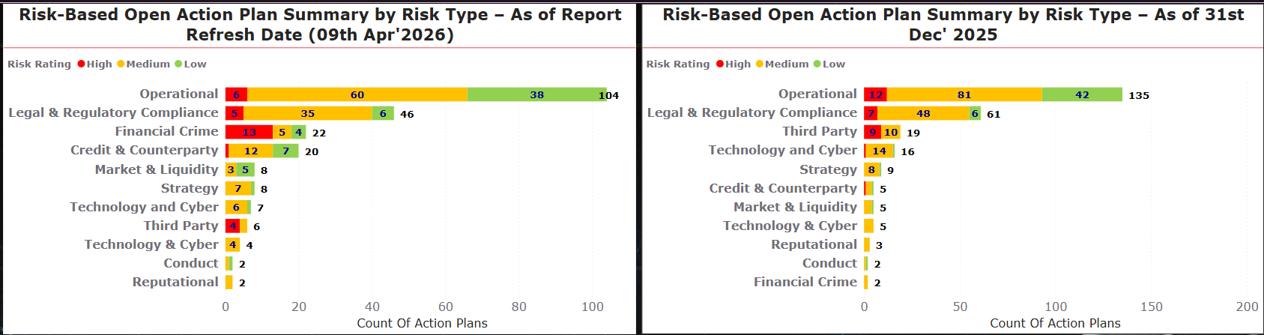
📃Daily Report
Risk Trends
Open Action Plan Review & Closure Trends
* Data Analysis Time Period : 3rd June 2022 to 9th April 2026
Commentary
Overall risk remediation momentum remains positive, with a ~12% reduction in total open action plans.
Operational and Regulatory risks remain dominant, though materially reduced, indicating effective closures (135 → 104, ~23% and 61 → 46, ~25%).
Third‑Party related open issues decreased materially, with open action plans declining from 19 to 6 (~68%).
Increases in Credit, Technology, Market & Liquidity, and Financial Crime risks reflect audits completions and expanded coverage.
17
Notes:
slicer
No alt text provided
slicer
No alt text provided
slicer
No alt text provided
shape
No alt text provided
Open Action Plan's Thematic Distribution
No alt text provided
Audit Details
No alt text provided
Risk Acceptance & Exemption (Division-wise)
No alt text provided
Audit Name
No alt text provided
card
No alt text provided
textbox
No alt text provided
Upcoming Action Plans
No alt text provided
Open Action Plans By Risk Rating
No alt text provided
actionButton
No alt text provided
Distribution Of Open Action Plans
No alt text provided
Action Plan Status - Last 3 Months
No alt text provided
Open Action Plans
No alt text provided
Open Overdue Action Plans
No alt text provided
Overdue (Under GIA Validation)
No alt text provided
Closed Action Plans - Last 30 Days
No alt text provided
Overdue Ageing For Open Action Plans
No alt text provided
shape
No alt text provided

Slide 18
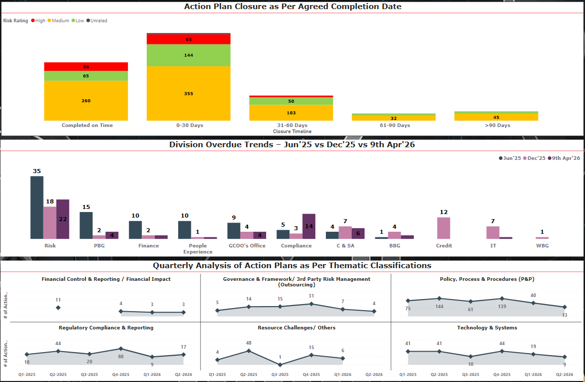
📃Daily Report
Risk Trends
Four‑quarter view of action plan progress, overdue trends and recurring themes.
Commentary
Action Plan Closure vs Agreed Timelines
Majority of actions are closed on time or within 30 days, indicating generally effective remediation discipline.
Delays beyond 60 days remain limited, suggesting slippage is contained and not systemic.
Division‑wise Overdue Trends
Overall overdue trends have declined across most divisions, reflecting improved follow‑up and accountability.
People Experience and GCOO Divisions have noticeable improvement.
Thematic Trend Analysis
Thematic trends indicate improved process maturity.
Sharp declines in Policy, Process & Procedures, Governance & Framework, Technology & Systems, and Resource Challenges from Q4‑2025 to Q1‑2026.
Regulatory Compliance & Reporting also shows stabilizing trend, aligned with periodic regulatory audit cycles.
* Data Analysis Time Period : 1st June 2024 to 09th April 2026
18
Notes:
slicer
No alt text provided
slicer
No alt text provided
slicer
No alt text provided
shape
No alt text provided
Open Action Plan's Thematic Distribution
No alt text provided
Audit Details
No alt text provided
Risk Acceptance & Exemption (Division-wise)
No alt text provided
Audit Name
No alt text provided
card
No alt text provided
textbox
No alt text provided
Upcoming Action Plans
No alt text provided
Open Action Plans By Risk Rating
No alt text provided
actionButton
No alt text provided
Distribution Of Open Action Plans
No alt text provided
Action Plan Status - Last 3 Months
No alt text provided
Open Action Plans
No alt text provided
Open Overdue Action Plans
No alt text provided
Overdue (Under GIA Validation)
No alt text provided
Closed Action Plans - Last 30 Days
No alt text provided
Overdue Ageing For Open Action Plans
No alt text provided
shape
No alt text provided

Slide 19
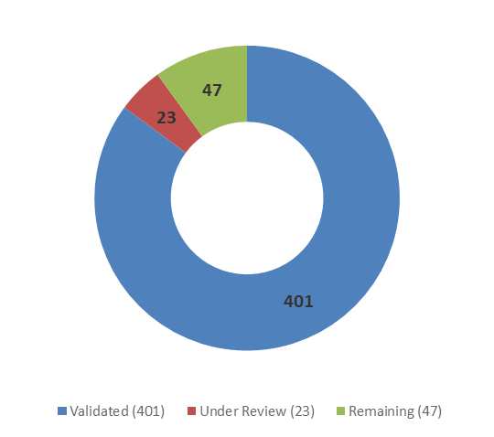
CBUAE Action Plan Validation – GIA Update
Overview of CBUAE Examinations
GIA Validation
9
Completed and actions under validation
GIA validation of regulatory actions remains resource-intensive, requiring detailed discussions and testing, evidence verification, and alignment to ensure CBUAE requirements are properly met. GIA is also providing support during establishment of Management action plans.
3
Ongoing reviews
4
Reviews to start
* These include upcoming Market Conduct examinations
Validation Progress
Actions Under Validation
82%
of CBUAE action plans
validated by GIA
401 / 487
Items | Number | Man-hours
Total actions | 487 | 3,896
Total actions validated | 405 | 3,240
Actions validated since last BAC | 58 | 464
Actions to be validated | 86 | 688
On average, validation of a CBUAE action requires approximately 8–10 man hours, including evidence review, discussion with action owners, and internal validation procedures.
19

Slide 20
CBUAE Action Plan Validation – Detailed Breakdown
CBUAE Examination | #Findings | #Actions | Resolved by Action Owner & Updated in TeamMate | Under review by GIA | Validated by GIA | To be Reviewed & Validated by GIA
AML/CFT Follow-up Examination 2025 | 23 | 55 | – | 7 | 20 | 35
Market Conduct Limited Scope Examination 2025 | 9 | 54 | 47 | – | 47 | 7
Market Conduct Limited Scope Examination 2025 – C3 Edenred Holding Ltd | 6 | 18 | 16 | 16 | – | 18
Control Functions Limited Scope Examination 2025 | 14 | 24 | 23 | – | 23 | 1
Shari’ah Examination 2025 | 6 | 17 | 8 | – | – | 17
Pillar 2 capital 2025 examination | 2 | 3 | – | – | – | 3
SCA AMLCFT examination | 3 | 4 | 1 | – | 1 | 3
Baseline Examination 2022 | 122 | 299 | 298 | – | 298 | 1
BRF Thematic Review 2023 | 5 | 13 | 12 | – | 12 | 1
Total | 190 | 487 | 405 | 23 | 401 | 86
All CBUAE examinations where actions have been completely remediated, validated and closed are not shown in this table.
20

Slide 21
Key Observations & Conclusion CBUAE Examination Edenred – Finding 3 - Action Point C​
Internal Audit Review of Unclaimed Funds
Background
Objective
• CBUAE mandated Internal Audit review of unclaimed funds processes and governance and reports its findings to BAC.
• Scope covers Edenred C3 prepaid card program under Mastercard BIN sponsorship
To provide independent assurance over the adequacy of the Bank’s governance, oversight, and control framework unclaimed funds, and to assess alignment with applicable regulatory expectations.
Scope of Review
Operating Context
• Dormancy identification and ageing processes
• Governance and oversight framework (Bank and Edenred)
• Customer claim validation and refund processing
• Regulatory transfers and dormant balance handling
• Refund initiation and processing controls
C3 Edenred maintains customer information of unclaimed balances and that the Banks procedures commence based on the customer information provided by C3 Edenred, Internal Audit reviewed the appropriate procedures, governance arrangements, and oversight mechanisms that are in place at the Bank level and at C3 Edenred to manage unclaimed funds.
!
Key dependency risk: Operational activities and data are largely managed by Edenred, with limited independent validation at Bank level.
Reference: Please refer to Annexure 8.18 for the Audit Memo
21

Slide 22
Key Observations and Conclusion
1
Bank-level Validation of Customer Claims and Refunds
Customer identification, supporting documentation review, and refund processing are operationally performed by Edenred in line with the agreed operating model. The Bank exercises oversights through defined roles & responsibilities and governance arrangements over third-party process. While this arrangement is supported by defined roles and responsibilities, the Bank does not independently perform validation of these activities.
As the cards are hosted on Ednered’s platform and certain operational activities are performed within that environment, the Bank’s assurance over the completeness and accuracy of claim assessments is dependent in part on the quality of the third-party reporting.
2
Independent Verification of Dormancy Status
Dormancy identification and ageing calculations are generated based on data originating from the Edenred platform under the current operating model, as the Bank does not have direct access to the underlying system. The Bank relies on third-party reporting and process outputs for this purpose, supported by its governance and review arrangements.
Conclusion
Compensating controls are in place, supported by regular reporting, Compliance review, and a PB OR field visit (Feb 2026) over the unclaimed balance process.
Edenred has applied for a CBUAE Stored Value Facility (SVF) licence; once approved, unclaimed balance movements will be managed in line with regulatory requirements.
Existing controls are considered adequate in the interim, and GIA will continue to monitor progress and track updates on the SVF licence status.
22

Slide 23
BAC Satisfaction Survey – FY2025 Results
4/4
Members rate
Governance Contribution
as Significant
4/4
Members rate
BAC Communication
Very Effective or above
4/4
Members rate
Audit Independence
as Excellent
1
Dimension noted
for attention - Agility
THEMATIC FEEDBACK & GIA'S 2026 COMMITMENTS
AREAS FOR IMPROVEMENT
RECOGNISED STRENGTHS
GIA'S 2026 COMMITMENTS
Business Growth & Emerging Risks
Leadership & Transformation
Business Growth & Emerging Risks
Greater focus on WBG, end-to-end product benchmarking, data management, analytics, fraud and market conduct; assess organisational bandwidth to deliver transformation and remain ahead of regulation.
BAC recognised the significant transformation of GIA under new leadership and the improved quality and alignment of the 2026 audit plan.
FY2026 plan includes enhanced WBG and product-focused audits, increased emerging risk coverage, and delivery capacity consideration during audit scoping for major transformation and regulatory initiatives. Market conduct reviews are also now embedded as part of Product Audits. Fraud risk was added to the 2026 audit and will remain under GIA’S radar.
Quantifying GIA's Value Add
Clearer articulation of GIA's contribution to risk management and control improvement — beyond completion of the audit plan.
Quantifying Value Add
Communication with BAC
2026 reporting enhancements focus on concise executive summaries, clearer articulation of value-added insights, and direct linkage of audit outcomes to risk and control improvement.
Strong quality of audit discussions and communication with the BAC — commended as a continued strength to build on.
Team Capability & Expertise
Team Capability
Ensuring the right level of specialist expertise within GIA to deal with an increasingly complex and evolving business environment.
Targeted capability-building continues in 2026, supported by specialist training and focused BAC communication on key risk themes and emerging issues. Staff skill and competency assessment will be refreshed periodically to identify any needed additional skills and expertise.
Audit Performance & Alignment
Technology Risk Coverage
Overall audit performance and alignment with key risks rated positively; clarity in presentations highlighted as a strength by members.
Technology Risk Coverage
Expanded coverage of IT Disaster Recovery, Digital Currency, and emerging technology risks aligned with the Bank's strategic roadmap and regulatory developments.
The 2026 audit plan includes targeted coverage of IT resilience, DR, and emerging technologies, aligned with the Bank's technology roadmap and regulatory developments. Targeted audit coverage of Digital Assets has been included in the 2026 audit plan.
4 BAC members surveyed · Results aggregated to preserve member confidentiality
23

